Slide 1

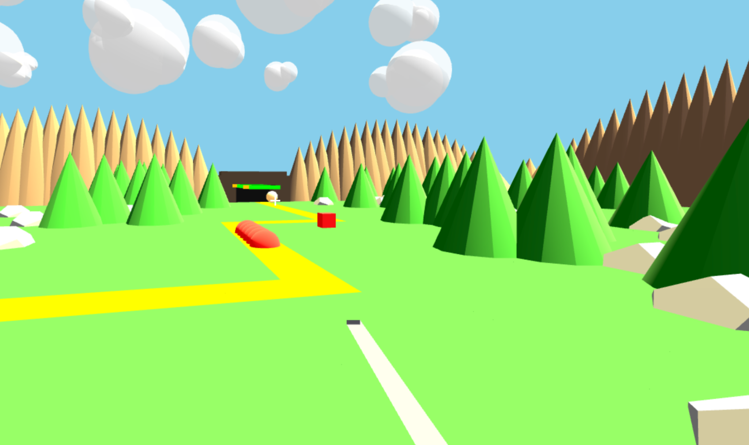

Blade & Bastion
Team Name: [Array] of Blades
Trevor C. & Allen Merrill

Slide 2

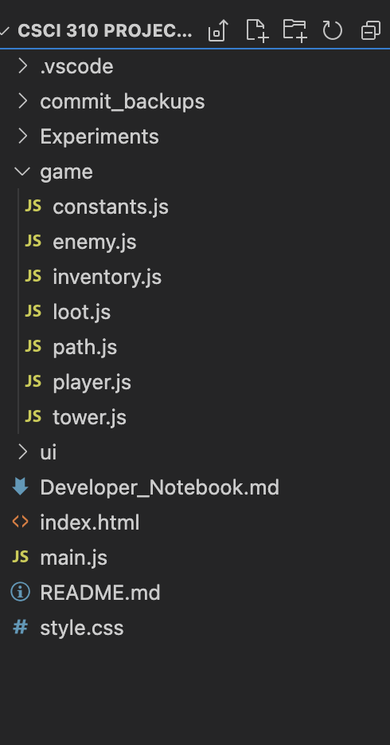

Tools & Folder Format
Git & GitHub: Central repository for project code. Used forks to merge work cleanly
AI Assistance: Use of chatgpt for skeleton code GitHub Copilot: Assisted with auto-completion and generating boilerplate code to speed up development.

Slide 3
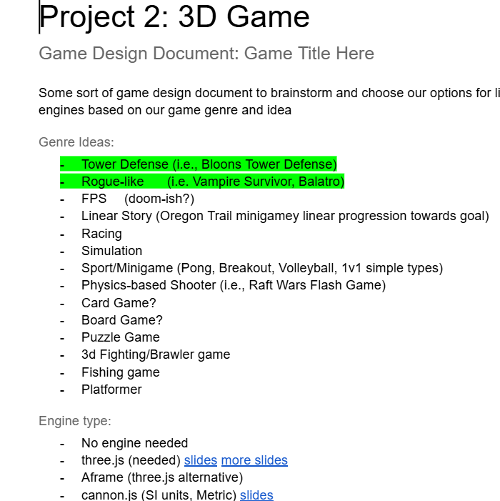
IDEATION
Game Design Document
First our team created a game design document.
We decided on all of our game ideas like:
What genre we would do
Our game story
Our win/loss conditions
Enemies, player, & more!

Slide 4
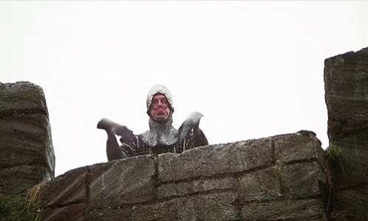
GAME STORY
The good guys are in an epic war for control of the realm and currently are losing to the bad guys.
In order to make a final stand, King Thorian Lighthelm set up defense at their strongest bastion
This final defense against the tyrannical emperor Emperor Malrik Bloodbane will rally the troops and turn the momentum

Slide 5
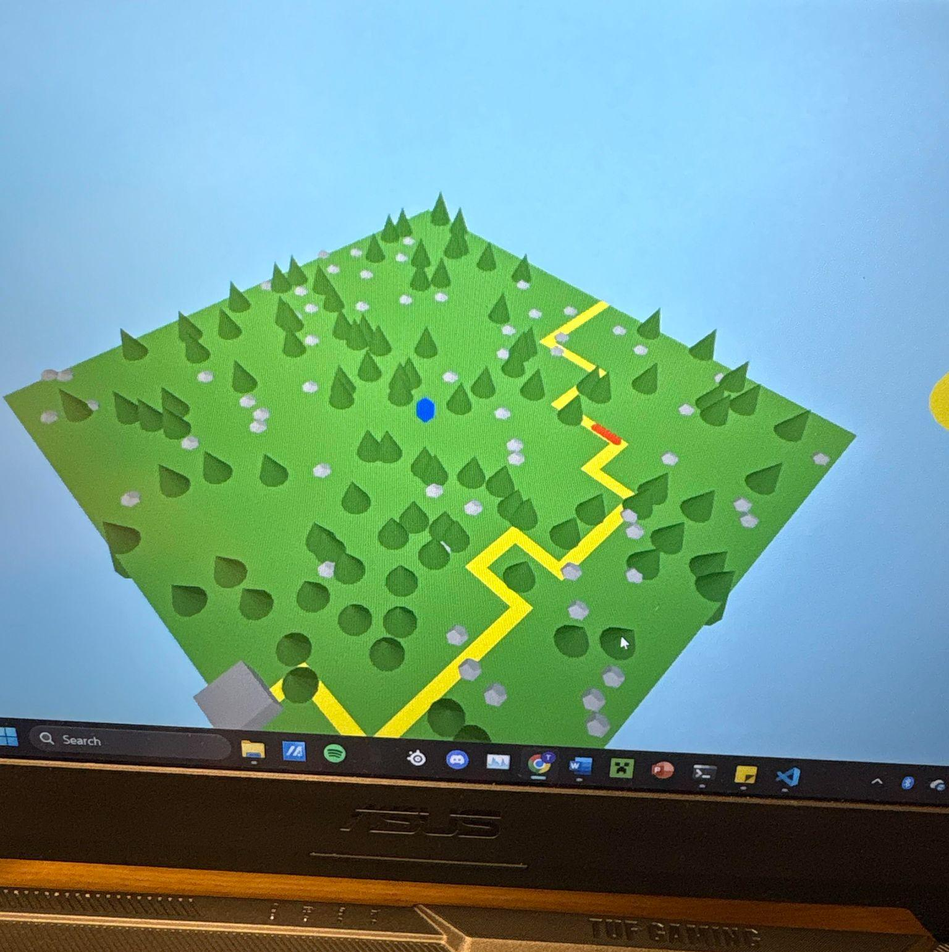
DEVELOPMENT
Beginning
To begin we created a simple scene with a top down camera
Added rocks
Added castles
Added path based on tiles of grid
Added a player that just moves

Slide 6
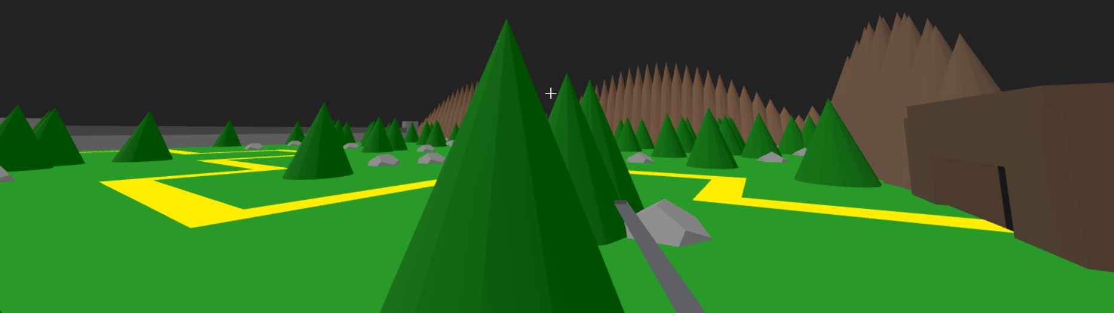
DEVELOPMENT
Scene Cont…
Continuing to develop the game we added first person and more geometry
We added a first person mode
We added a mountain range geometry
We added a cave for the enemies to have a spawn
We added a castle wall at the end
All of this allowed us to enclose the player in the map and continue development

Slide 7
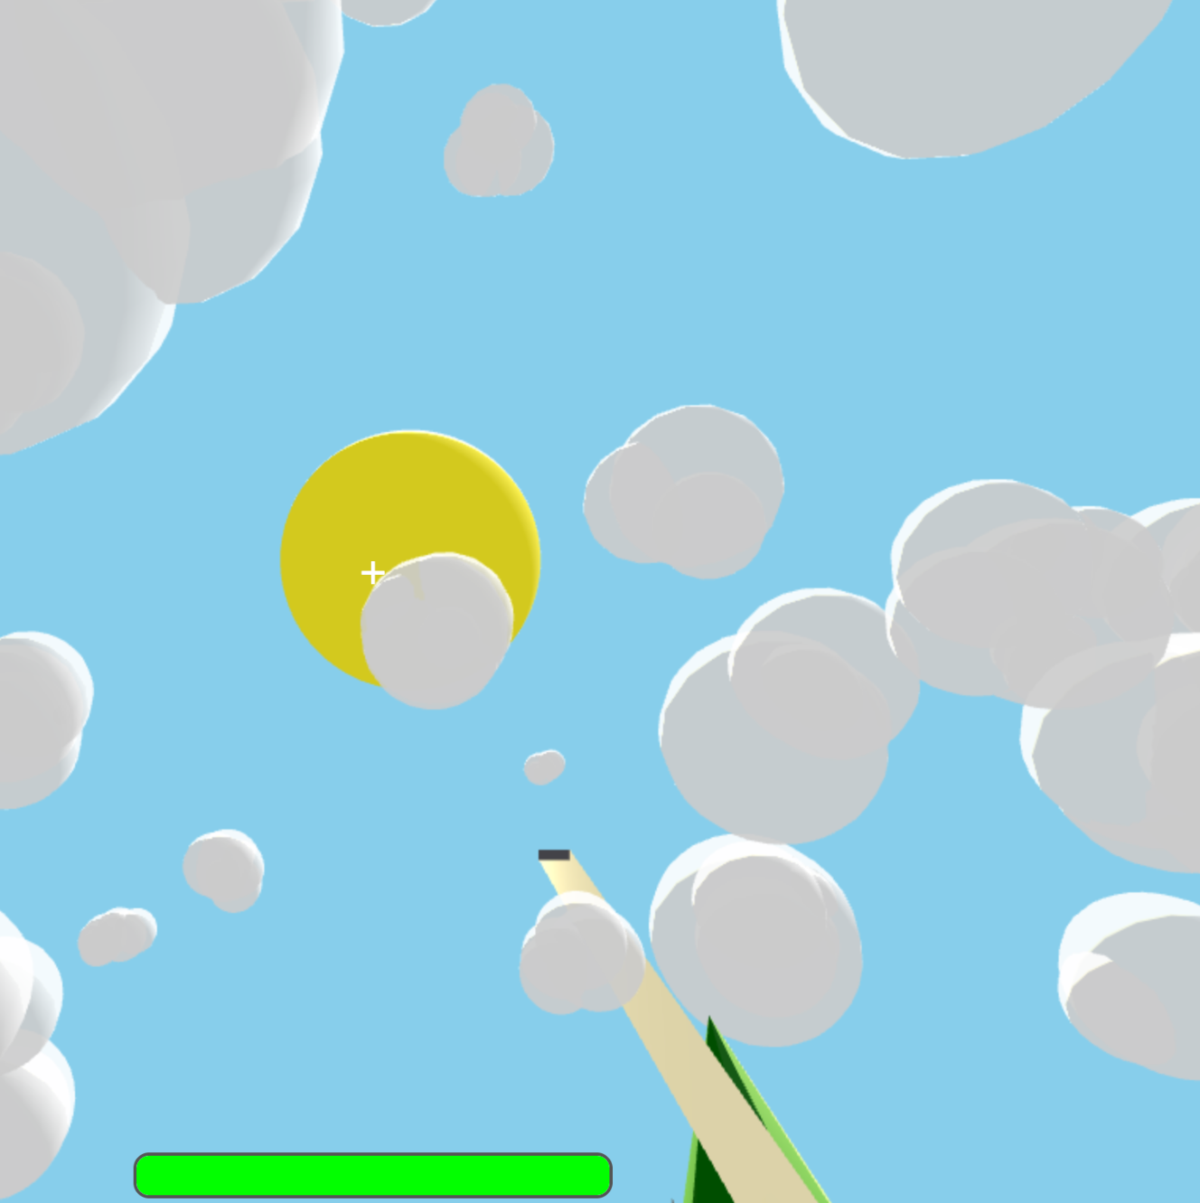
DEVELOPMENT
Finishing Scene
We finished the scene by building the sky
We created a 3d sun in the sky with light effects
Changed the sky color to blue
Created clouds that spawn randomly and move in the sky

Slide 8
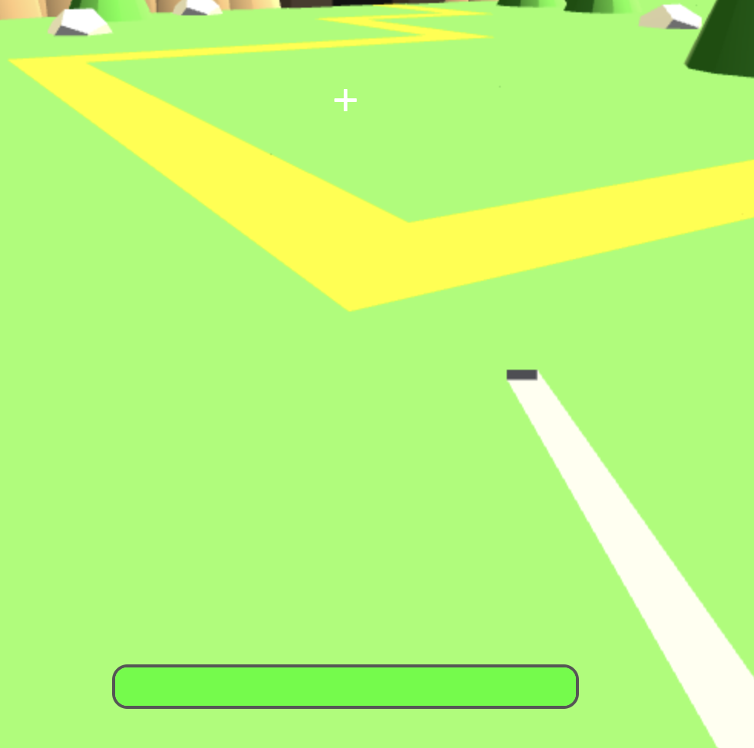
DEVELOPMENT
Player & Sword
Added features to our player
Sword attacks enemies on contact
Implemented health, damage, and cooldown
Visualized using Three.js 3D model

Slide 9
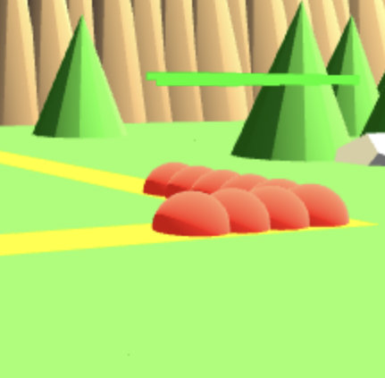
DEVELOPMENT
Enemies
Enemies for the player to fight
Designed multiple enemy types with unique behaviors
Used Three.js for 3D models and movement
Implemented health, damage, and AI targeting
Spawned along paths to challenge the player

Slide 10
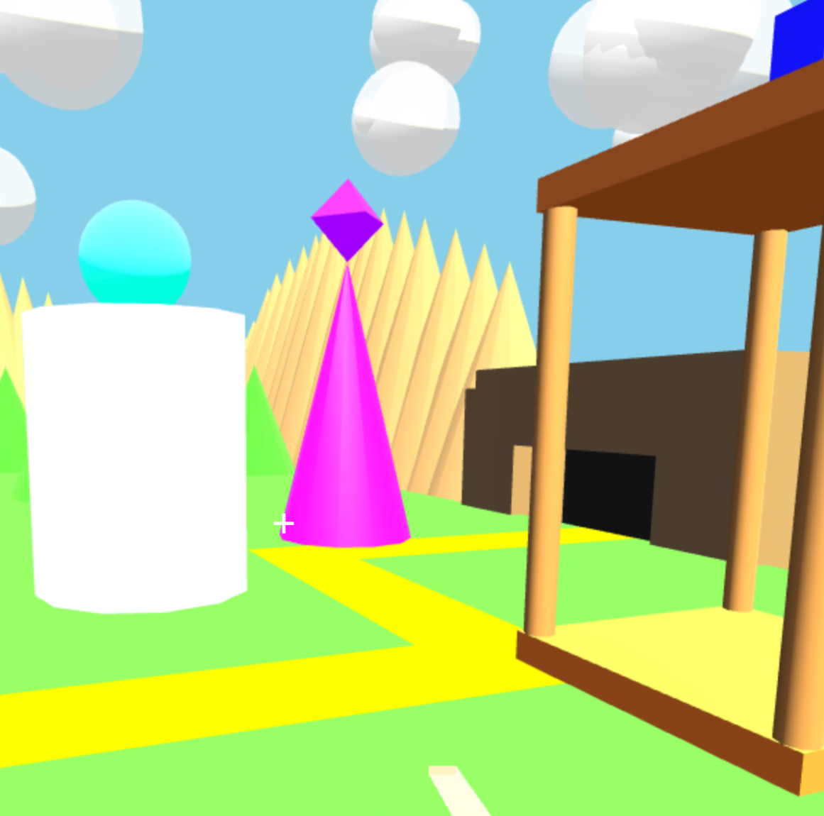
DEVELOPMENT
Towers
Created towers to support players in defense
Mage Tower: Attacks enemies with Aoe magic, short range
Archer Tower: Shoots arrows from, single target, high range
Healer Tower: Heals the players hp

Slide 11
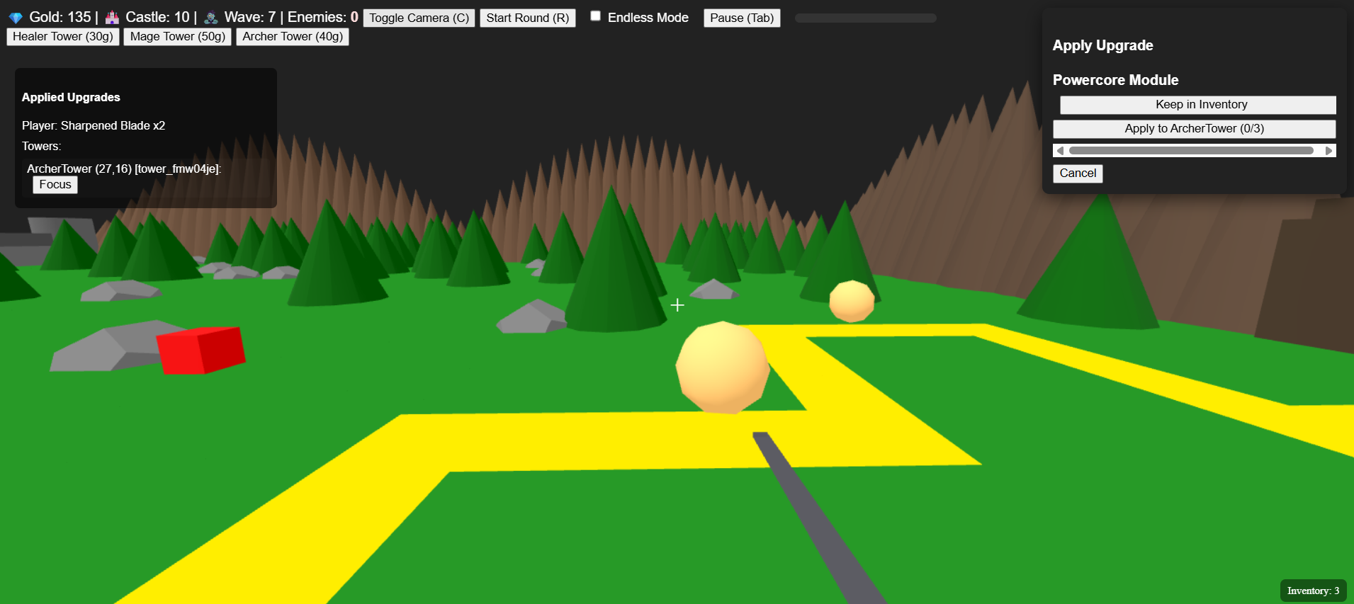
DEVELOPMENT
Loot & Economy
We aimed to also have the game be a bit of a rogue-like. To facilitate this we added loot drops for the player and towers. We also added an economy as the player gains coins with every enemy death.
Towers cost gold coins
Player can get powerups
Goal Hoard - increases gold gained
Sharpened Sword - increases melee damage
Towers can get upgrades
Overclock Chip - increases tower fire rate by 30% each tower gets one
Powercore Module - Increases tower damage by 18% each tower can have three

Slide 12
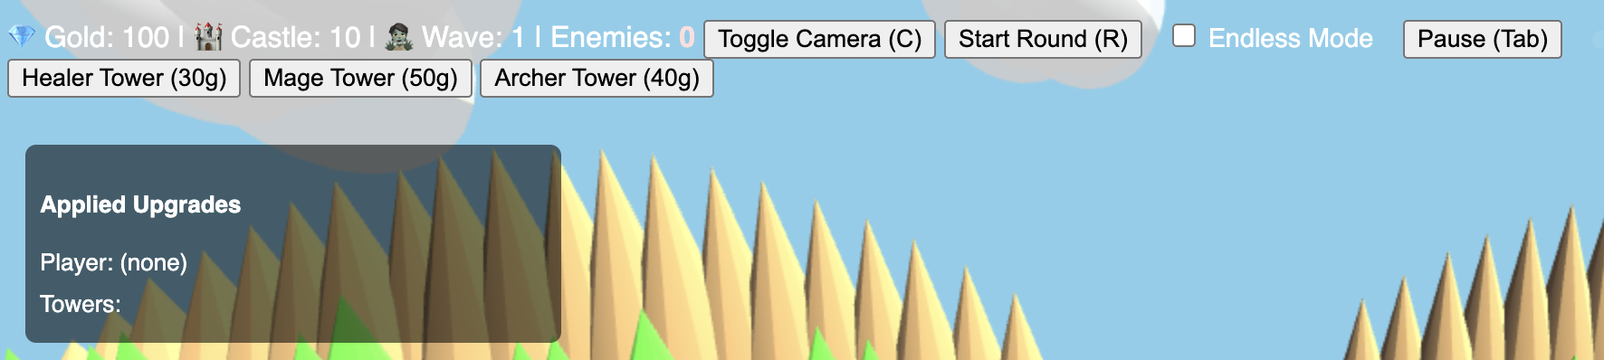
DEVELOPMENT
UI Development
Obviously to have the player interact and place and use things we needed a User Interface. In the UI we had several buttons:
Tower Buttons - buttons to place a tower labeled with their cost
Toggle Camera - changes between First Person and Top-Down Camera
Start Round & Pause
Economy, Wave, Health trackers
Inventory - a Storage system for when the player picks up more than one powerup at a time
Applied Upgrades Modal - Tracks player and tower upgrades

Slide 13
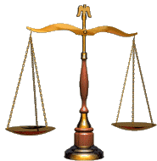
DEVELOPMENT
Balancing
Lastly once the core game was set the game needed a little balancing
Players damage was too much
Players range was too high
Mages damage was too high
Enemies did too much
Healer tower didn’t heal enough

Slide 14
Who did what?
Allen-
Created towers: Design, attacks
Created Player: Movement, Health, Part of the sword
Nature Aspects: Sun & Lighting, Clouds, Trees, Rocks
Made Enemies: Attack, Gave health bar, allowed death, take damage
Added game over on death
Trevor-
Created Path logic
Created loot: Drop %, Items
Dealt with inventory from drops
Handled Wave logic
Improved Scene: Castle, Cave
Added Tower Ghost when placing
Added Some Of the UIs
Added Constants export file
Added “toast” notifications

Slide 15
Q&A

